Slide 1
Remote attach Virtual GPUs for Any AI Application

Slide 2
Drawbacks on Traditional GPUs
Hard to predict the number of users, training and testing time
Results in difficulties to share GPUs across developers
GPU upgrade cycles can be frequent
Results in different capacity and efficiency of GPUs within same organization
GPU are isolated entities, independently administered
Causes GPUs to be unused or underutilized for long periods of time
Running Task with fixed number of GPUs
Results in resource waste

Slide 3
FlexDirect Provides
Dynamically attaches and detaches GPUs to remote workloads in real-time
An Unified Compute Resource Pool
The aggregation of GPUs from multiple systems
Slice and Aggregate GPUs to vGPUs of any size
Management on the GPUs
Maintaining policies for clients
Idle timeouts
Analytics tool to measure GPU utilization over time

Slide 4
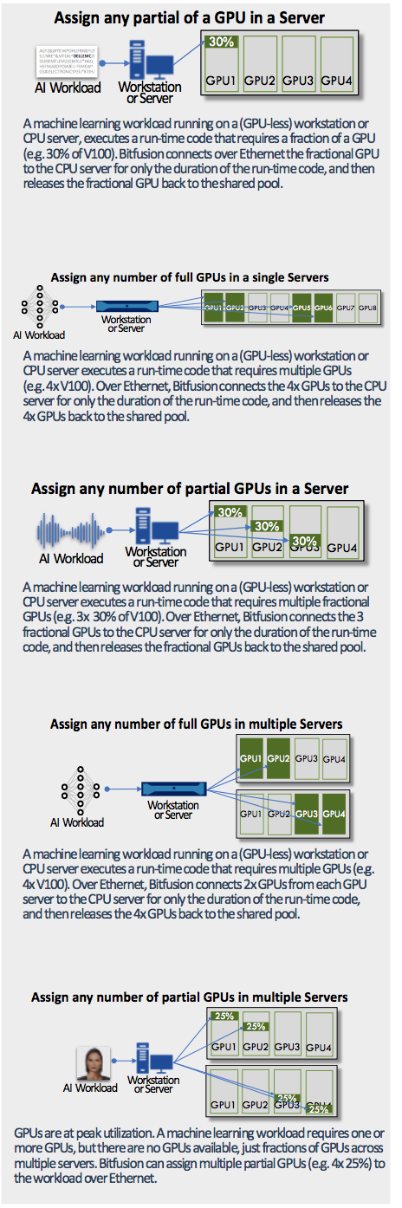
Aggregation of GPUs
Slicing of GPUs

Slide 5
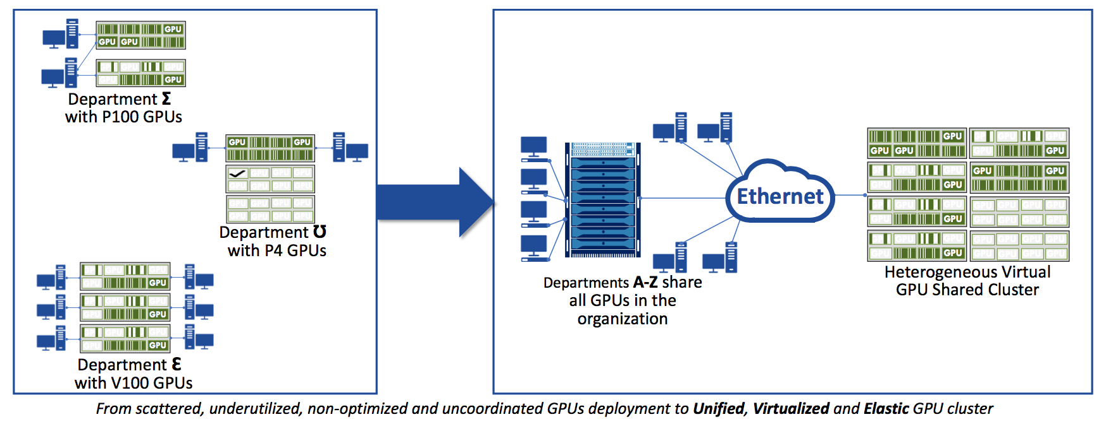

Slide 7
FlexDirect Cluster
Application Instance (Client)
Run AI application.
It can be a GPU instance, but it is not required that it be.
GPU Instance (Server)
The machines which provide GPU resources to the cluster.
Connects any GPU remotely, over Ethernet or NIC to resource pools
Works with existing bare metal, virtual machine (VM), Hypervisor, container

Slide 8
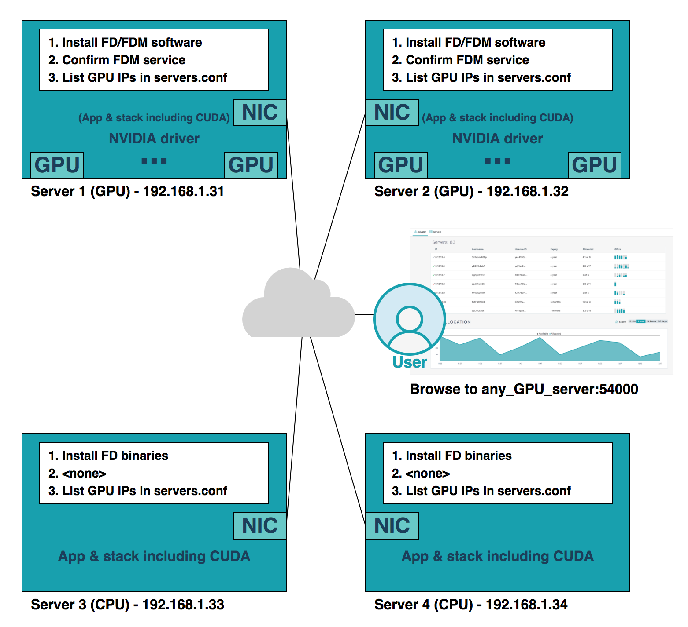
FlexDirect-Server Installation Script
Nvidia-driver
Cuda Run-Time Library
Cuda Developer Library
Servers.conf
Servers.conf
#Server1
192.168.1.31
#Server2
192.168.1.32
Tensorflow Gpu
Cuda Run-Time Library
Cuda Developer Library
Servers.conf
FlexDirect-Client Installation Script

Slide 9
How FlexDirect work
FlexDirect software is installed on the clients (either on bare metal, VM or container), and also on the GPU server.
Whenever user runs AI frameworks that require GPU resources, FlexDirect will make the on-demand assignment to the resource pool
Upon completion of the AI framework execution, FlexDirect will release the GPU resources back to the resource pool

Slide 10
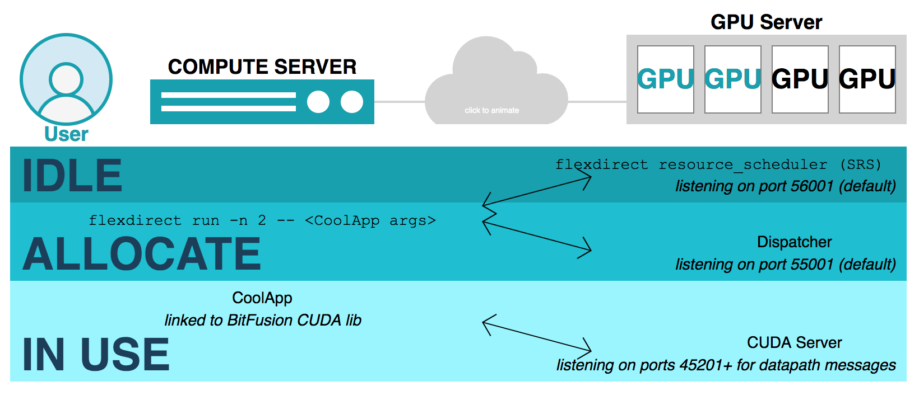
CLIENT
SERVER
Training Script
Training Data
CUDA Server -> Nvidia Driver ->
Nvidia GPU
Result

Slide 11
FlexDirect Usage - Client
Using GPUs from the Client
$ flexdirect run -n num_gpus [ [-p fraction_of_gpu] | [-m memory_per_gpu] ] <application and arguments>
Running Applications on the Local Server (using Local GPUs)
flexdirect local <application and arguments>
Reserving GPUs from client
flexdirect request_gpus -n 1 -p 0.5
flexdirect client <application and arguments>
Releasing GPUs from client
flexdirect release_gpus

Slide 12
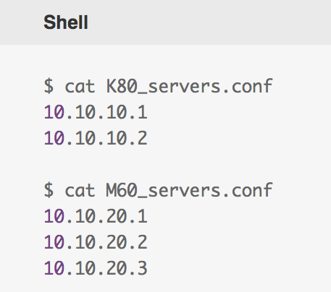
FlexDirect Usage - Server
Dividing GPU Resources by GPU Type from server
flexdirect run -n 2 -s M60_servers.conf <application and arguments>
Dividing GPU Resources into Multiple Pools from server
flexdirect resource_scheduler --devices 0,1 --srs_port 56001 --port 56002 &
flexdirect resource_scheduler --devices 2,3 --srs_port 57001 --port 57002 &

Slide 13
Flexdirect vs Network Relationship Experiments
Goal - Test the network latency on FlexDirect based on the distance between FD Server and FD Client
Training Job - tf_cnn_benchmark
Software
Hardware
ESXi | 6.7.0
FlexDirect Version | FlexDirect Version fd-1.11.7
OS | Ubuntu 16.04
Cuda | 9.0
Tensorflow-Gpu | 1.12.0
Nvidia Driver | 430.26
Host | Dell PowerEdge T320 Hosts 4 Intel(R) Xeon(R) CPU E5-2440 v2 @ 1.90GHz
GPU | GeForce GTX 1050 Ti
Interconnections | VMXNET 3

Slide 14
Test Case
FlexDirect Server
FlexDirect Client
GPU Server
FlexDirect Server
GPU Server
GPU Server
AI Application
FlexDirect Client
AI Application
AI Application
ESXI
#TestCase 0
#TestCase 1
#TestCase 2

Slide 15
Test Case
Same LAN
WCDC
Shanghai
FlexDirect Server
FlexDirect Client
FlexDirect Server
FlexDirect Client
GPU Server
GPU Server
AI Application
AI Application
#TestCase 3
#TestCase 4

Slide 16
Result
VM Latency Sensitivity
Normal -> High
0.94
0.88
0.89
0.65

Slide 17
Resources
Bitfusion-FlexDirect Client and Server Installation and Usage Guide
https://confluence.eng.vmware.com/display/NIMBUS/Bitfusion-FlexDirect+Client+and+Server+Installation+and+Usage+Guide
Bitfusion Flexdirect vs Network Relationship Experiments (tf_cnn_benchmark)
https://confluence.eng.vmware.com/pages/viewpage.action?pageId=454087256
Bitfusion Flexdirect vs Network Relationship Experiments (Mnist)
https://confluence.eng.vmware.com/pages/viewpage.action?pageId=451860601

